Slide 1


Azure SQL for Beginners Performance Troubleshooting Waiting due to blocking
Special Edition
#azuresql
aka.ms/azuresql4beginners

Slide 2


Performance is “slow” = Running vs Waiting
Low or
no CPU
High CPU
What queries are the top resource consuming queries or are waiting?

Slide 3



Running vs Waiting Scenarios
High CPU
Waiting
Missing Index
Blocking
Anti-pattern queries
Deadlocks
Lack of resources
Memory Grants

Slide 4



What is blocking?
BEGIN TRAN
SELECT *
FROM [SalesLT].[SalesOrderDetail];
BEGIN TRAN
DELETE
FROM [SalesLT].[SalesOrderDetail]
WHERE SalesOrderID = 71915;
[SalesLT].[SalesOrderDetail]

Slide 5
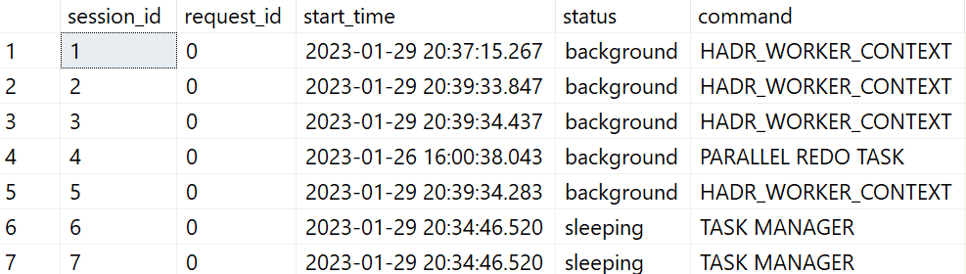
What is a Dynamic Management View (DMV)?
230+ DMVs
SELECT * FROM sys.dm_exec_requests;
sessions
memory
requests
query plan
tasks

Slide 6
The troubleshooting process
Identify low or no CPU
Check to see if blocking using DMVs
Terminate session for lead blocker
Apply best practices to avoid future blocking problems
Look at query store for top resource consuming queries or wait statistics
Try it yourself at https://aka.ms/azuresqlworkshop

Slide 7
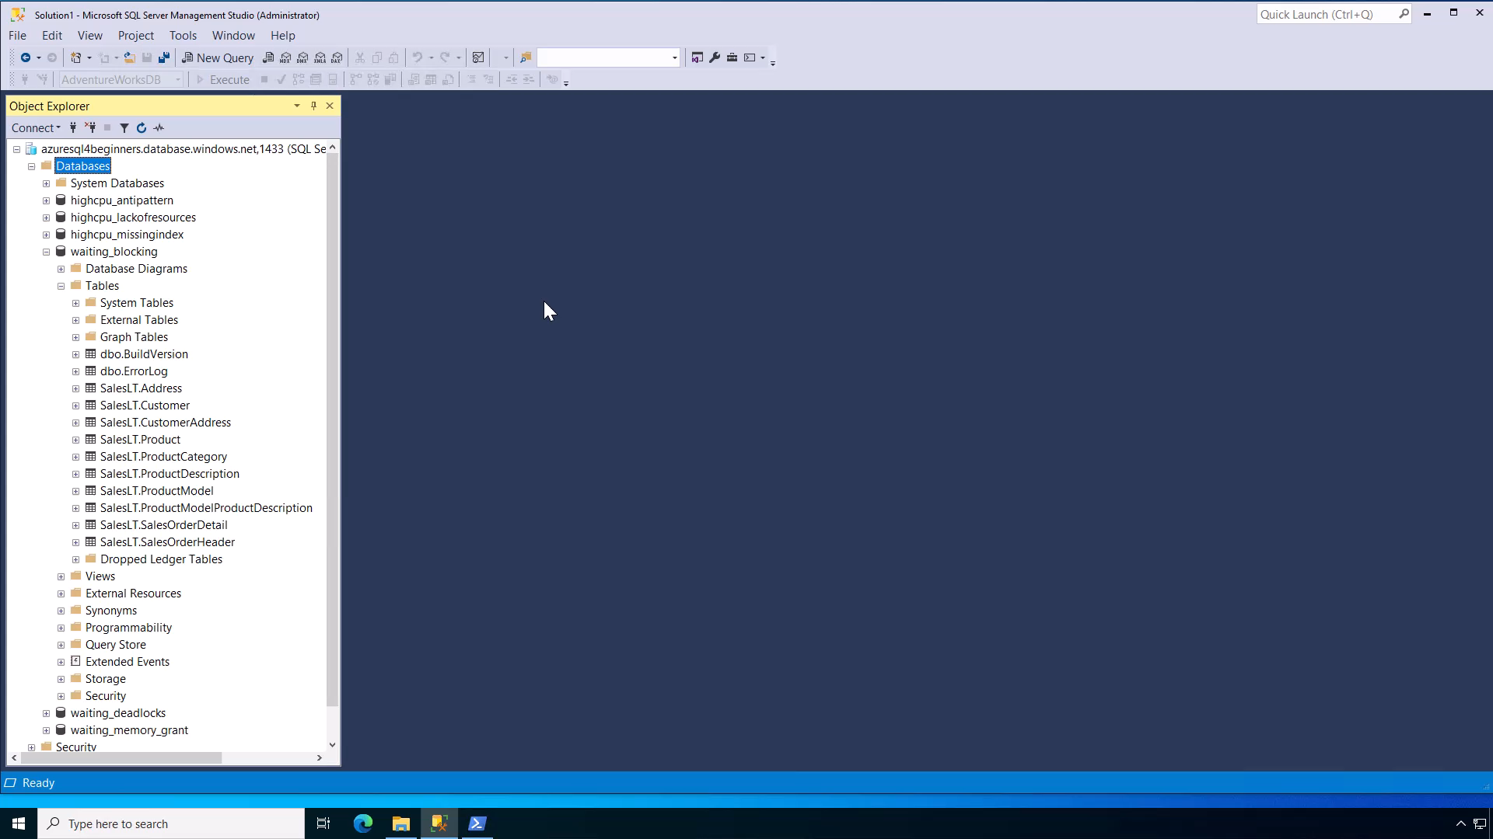
Notes:
30 secs

Slide 8
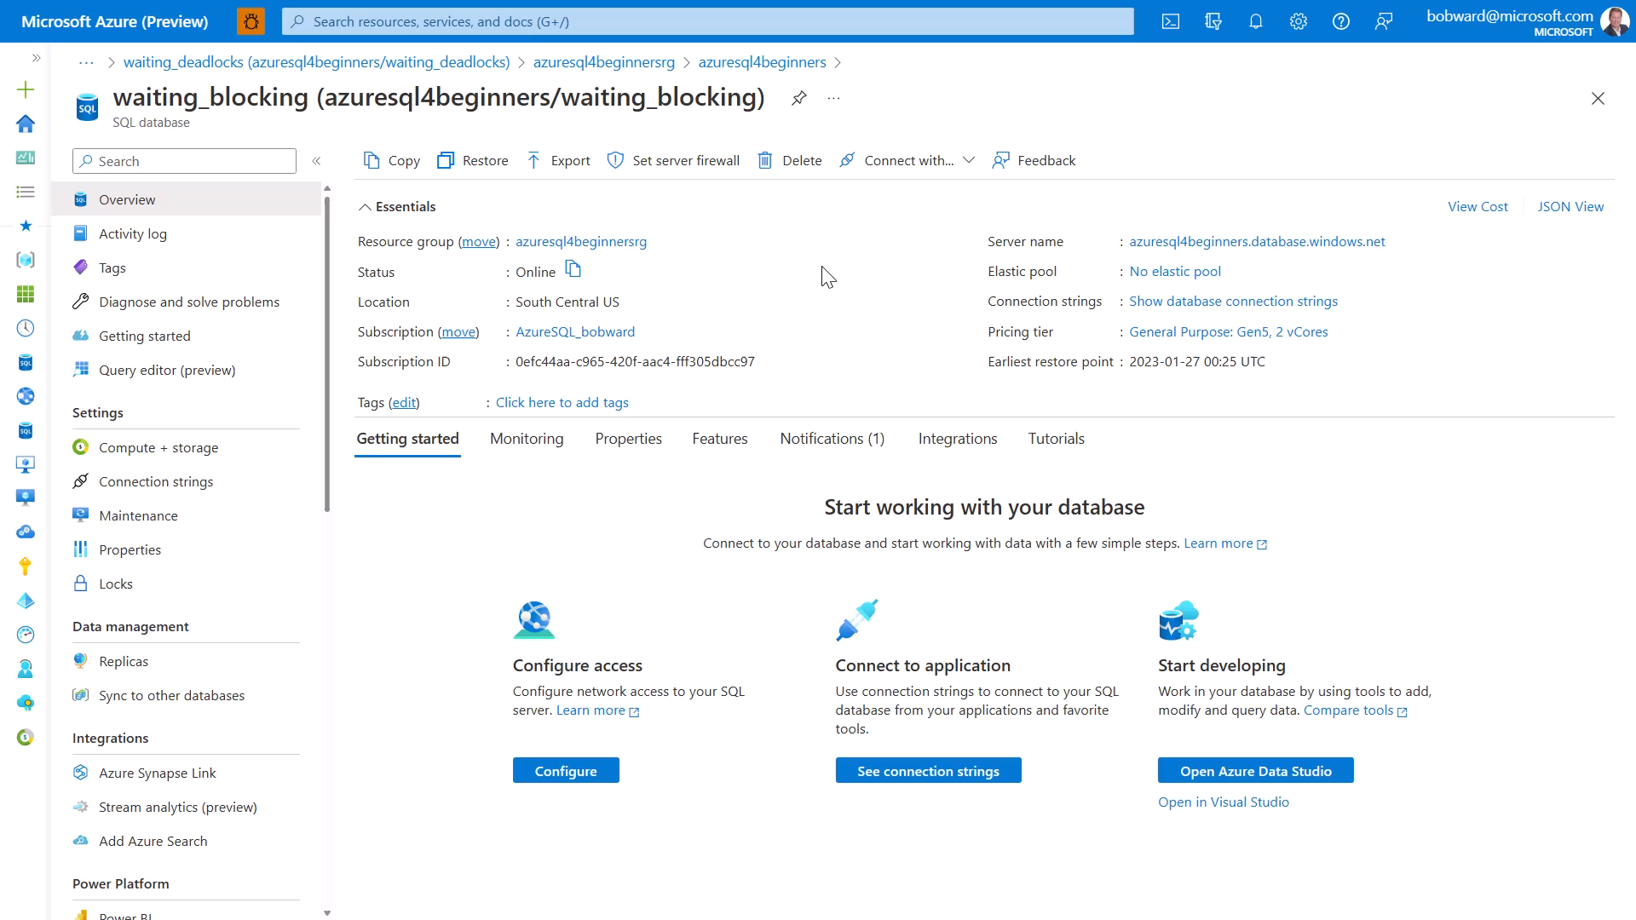
Notes:
30 secs

Slide 9
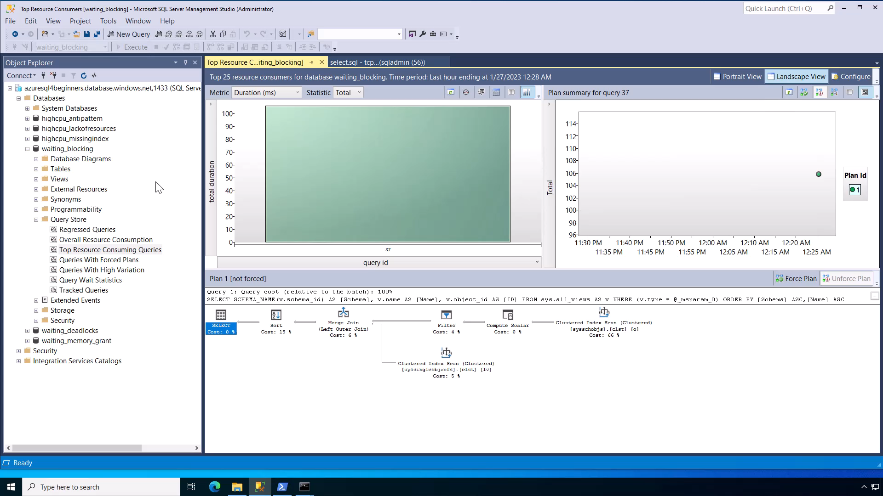
Notes:
30 secs

Slide 10
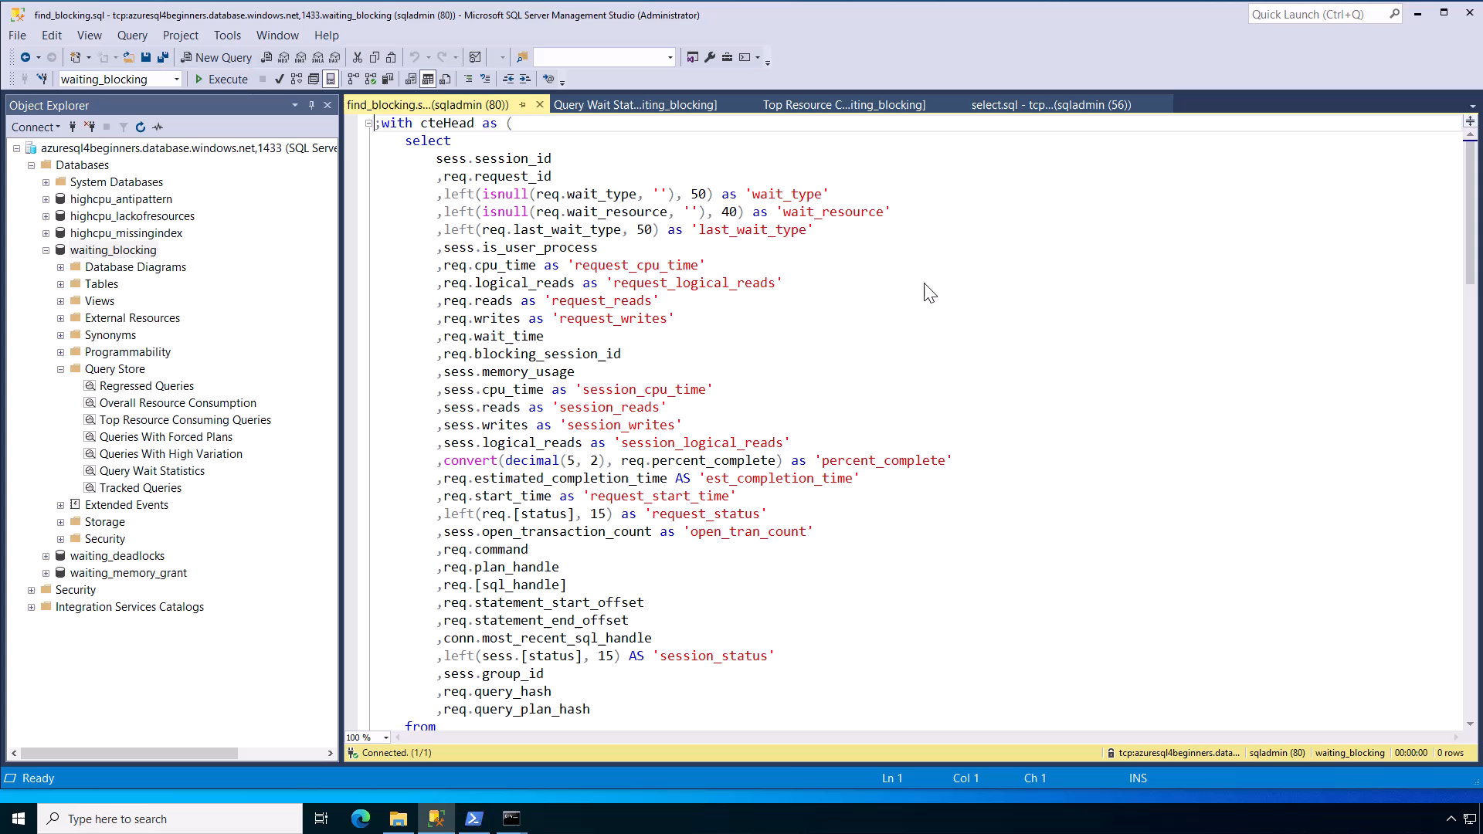
Notes:
1 min 45 secs

Slide 11
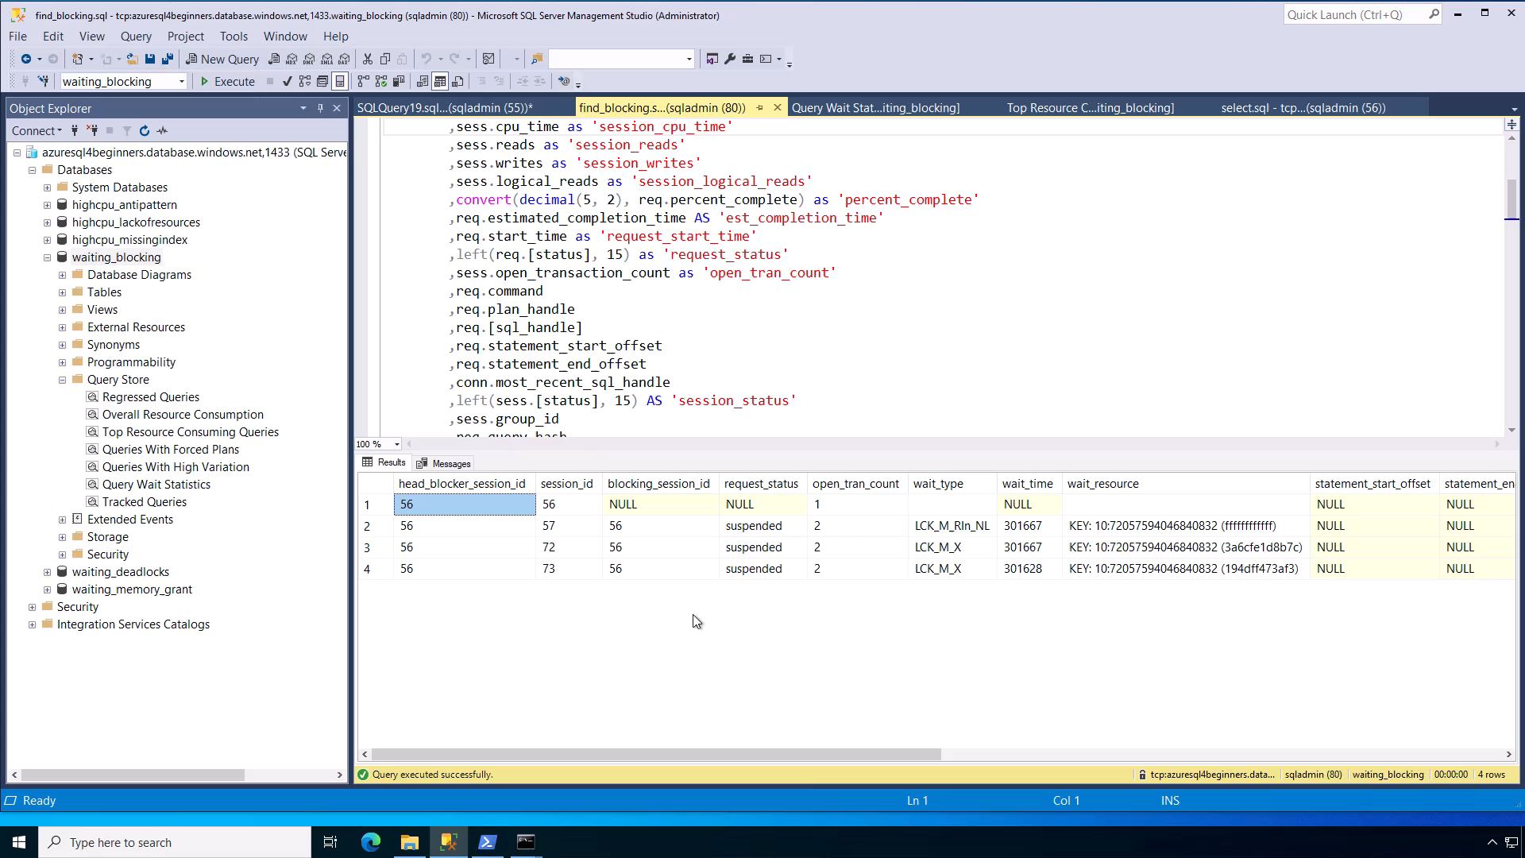
Notes:
30 secs
Demo total = 4 mins

Slide 12

Best practices to avoid blocking problems
Common
in Java applications
Keep transactions short
Look out for implicit transactions
Use proper indexes
Tune queries
Use Read Commit Snapshot Isolation (RCSI)
Take advantage of the new optimized locking
You may need to diagnose with Extended Events
aka.ms/azuresqldbxevent
aka.ms/optimizedlocking

Slide 13
Summary
SQL performance problems are either running or waiting.
SQL performance problems typically involve finding out what queries are involved.
If you have low or no CPU it could be a waiting problem.
Use Dynamic Management Views (DMV) to identify the blocking problem and lead blocker. Terminate the lead blocker session for immediate relief.
Use best practices to avoid blocking problems in the future

Slide 14


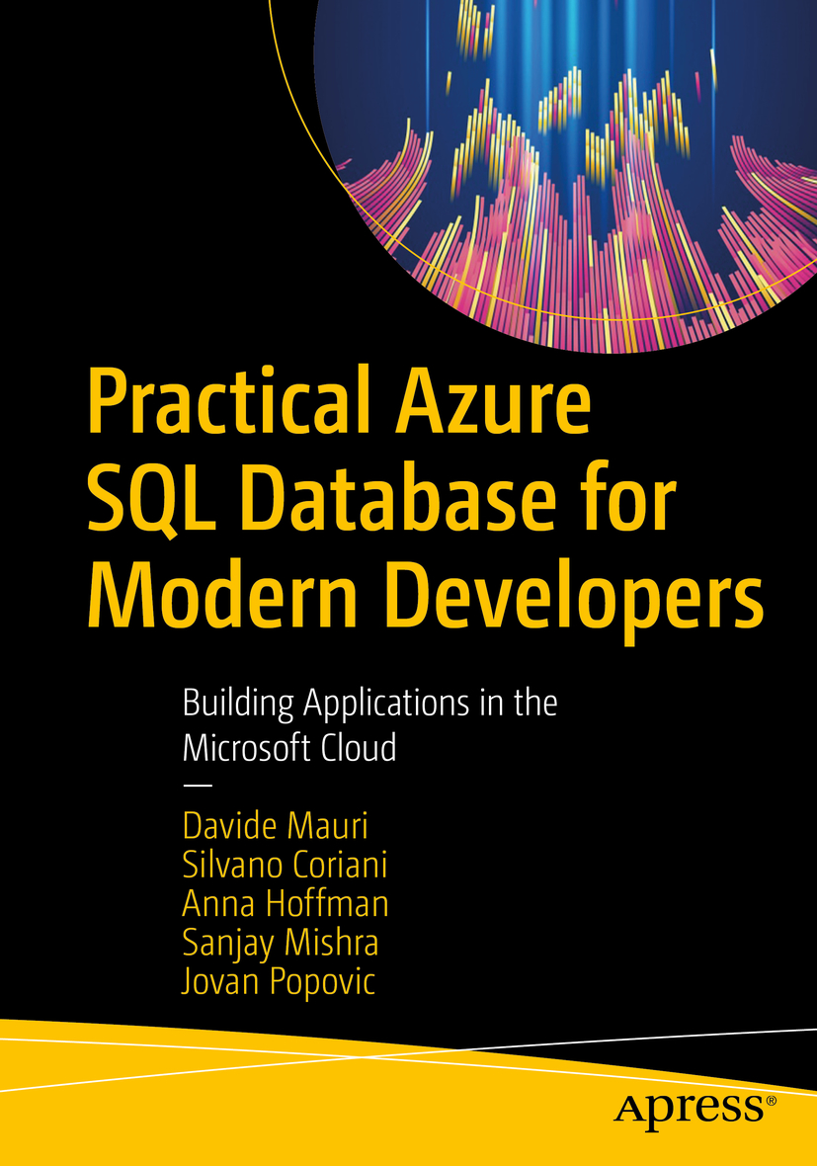


Learn more
Resolve your blocking problems
aka.ms/azuresqldbblocking
Azure SQL for Beginners
aka.ms/azuresql4beginners
Azure SQL Workshop
aka.ms/azuresqlworkshop
aka.ms/azuresqlbook
Azure SQL Fundamentals
aka.ms/azuresqlfundamentals
Watch Data Exposed
aka.ms/dataexposed
See more videos from our team
aka.ms/azuresqlyt
Follow us on social media
aka.ms/azuresqltwitter
aka.ms/azuresqlfordevelopers

